Slide 1
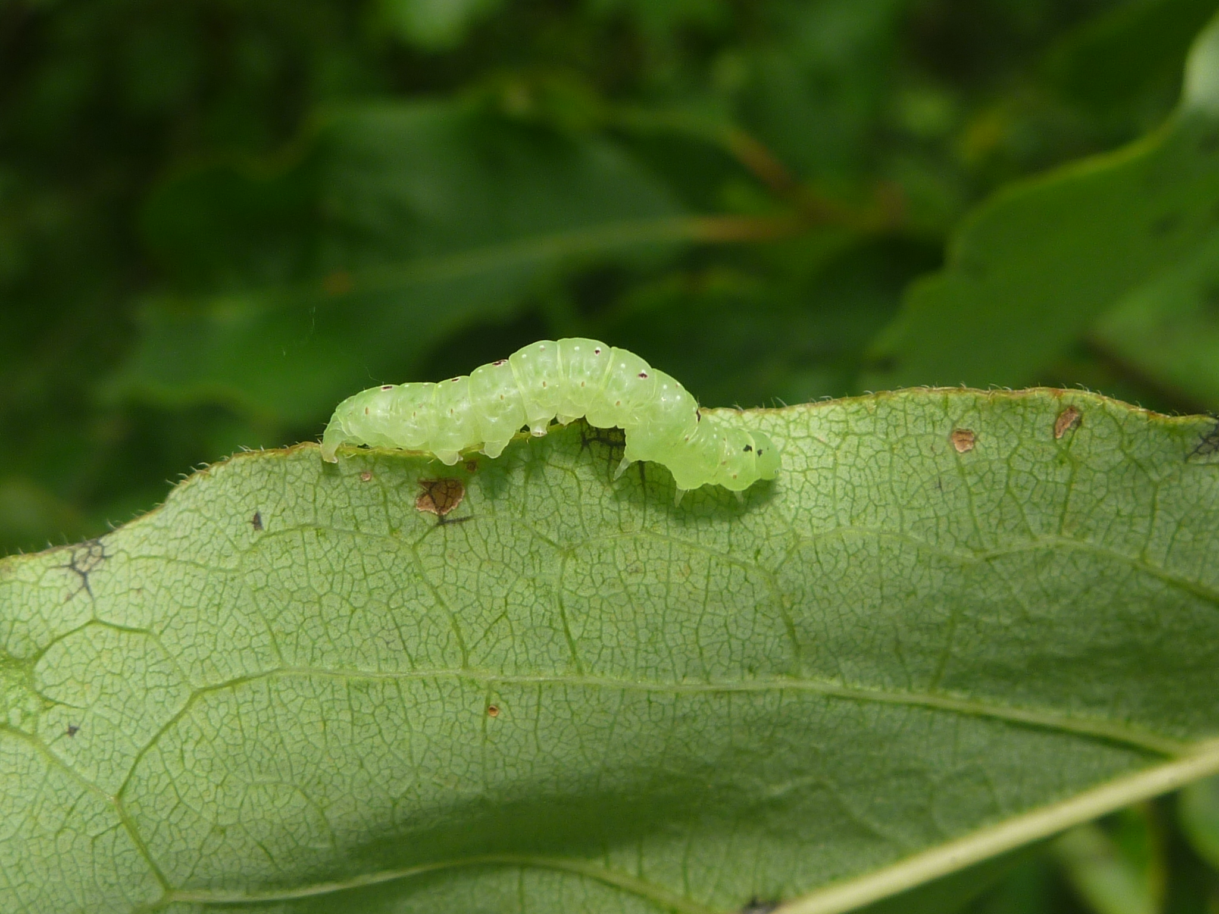
Caterpillars Count!
What have we learned?
Allen Hurlbert UNIVERSITY OF NORTH CAROLINA-CHAPEL HILL
Notes:
Today is all about discovering new ways to engage people at your sites. I’ve found that citizen science is a great way to get folks involved in science and in nature. People have an innate curiousity about the natural world, since they were little kids, and citizen science is a wonderful way for them to satisfy that curiosity and contribute to scientific research. At the same time, scientists are able to harness the power of so many more people than they usually would.

Slide 2
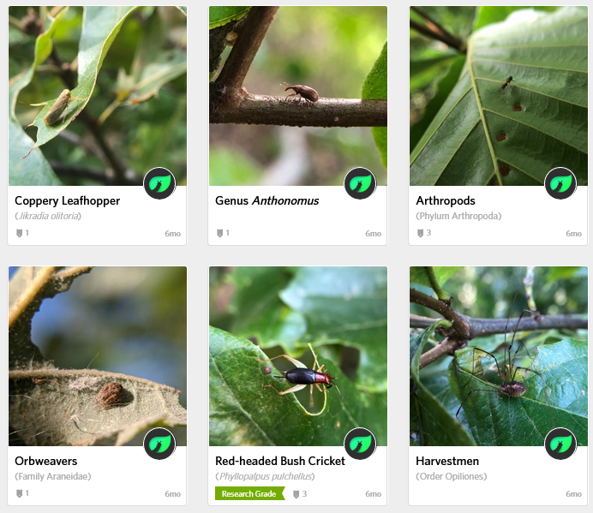
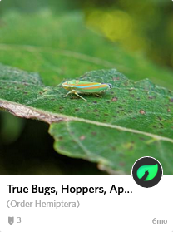
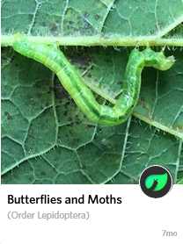
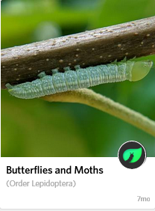
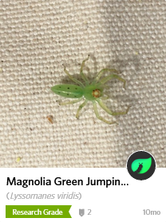
What have we learned?
Citizen scientists provide useful data on arthropod
composition, abundance, and phenology
Caterpillar occurrence
Date
Hurlbert et al. 2019, Citizen Science Theory & Practice
Notes:
Comparisons between data collected by trained scientists and citizen scientist volunteers confirmed that citizen scientists report similar patterns of arthropod composition

Slide 3
What have we learned?
Citizen scientists provide useful data on arthropod
composition, abundance
Caterpillar occurrence
Date
Date
Hurlbert et al. 2019, Citizen Science Theory & Practice
Notes:
abundance
(each data point is an arthropod group, color-coded as in the first panel, with density estimates of trained scientists on the x and estimates by citizen scientists on the y)

Slide 4
What have we learned?
Citizen scientists provide useful data on arthropod
composition, abundance, and phenology
r = 0.50
Caterpillar occurrence
Caterpillar occurrence
Date
Date
Hurlbert et al. 2019, Citizen Science Theory & Practice
Notes:
and phenology, or seasonal timing
(trained scientist data in black, citizen scientists in gray)

Slide 5
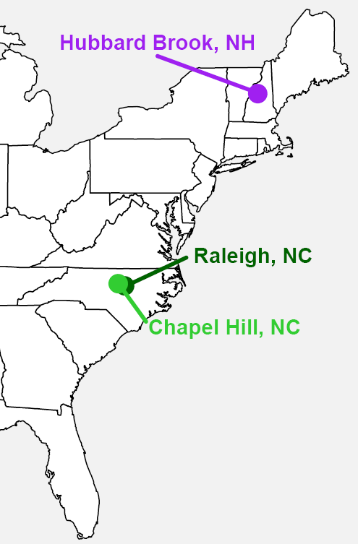
Bugs: quantifying bird food
The timing of the seasonal peak

Slide 6
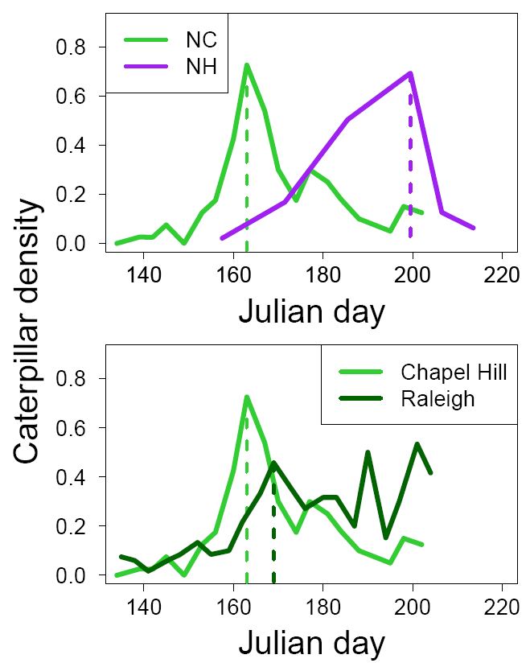
Bugs: quantifying bird food
The timing of the seasonal peak varies with latitude
37 days
Caterpillar density
Jun-1 Jul-1 Aug-1
6 days
Jun-1 Jul-1 Aug-1

Slide 7
Bugs: quantifying bird food
The timing of the seasonal peak varies with latitude but also within regions
37 days
Jun-1 Jul-1 Aug-1
6 days
Jun-1 Jul-1 Aug-1

Slide 8
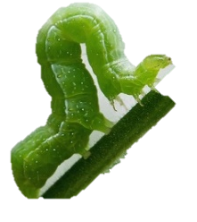
What have we learned?
Caterpillar Phenology
North Carolina Botanical Garden

Slide 9
What have we learned?
Caterpillar Phenology
North Carolina Botanical Garden

Slide 10
What have we learned?
Caterpillar Phenology
North Carolina Botanical Garden

Slide 11
What have we learned?
Caterpillar Phenology
North Carolina Botanical Garden

Slide 12
What have we learned?
Caterpillar Phenology
North Carolina Botanical Garden

Slide 13
What have we learned?
Caterpillar Phenology
North Carolina Botanical Garden

Slide 14
What have we learned?
The timing and abundance of bird food varies A LOT between years!
Caterpillar Phenology
North Carolina Botanical Garden

Slide 15
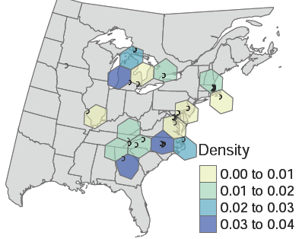
What have we learned?
The abundance of bird food varies A LOT from place to place!
Caterpillar Density
Low
High
Di Cecco and Hurlbert 2022

Slide 16
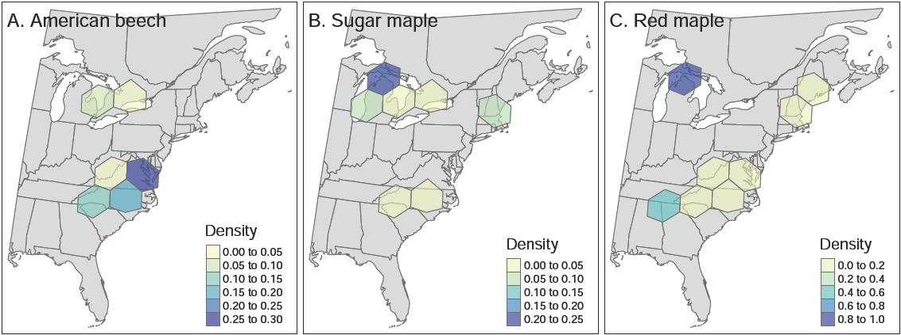
What have we learned?
The abundance of bird food varies A LOT from place to place!
And with host plant species.
Caterpillar Density
Low
High
Low
High
Low
High
Di Cecco and Hurlbert 2022

Slide 17
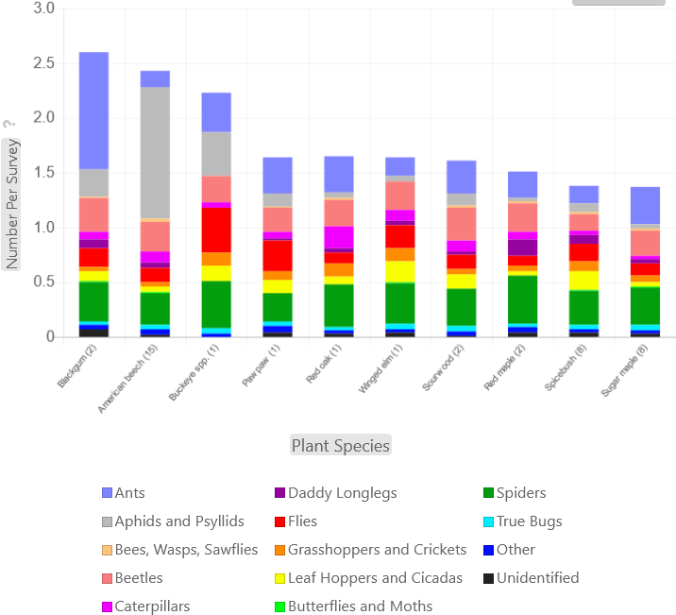
What have we learned?
The abundance of bird food varies A LOT from place to place!
And with host plant species.

Slide 18
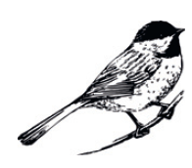
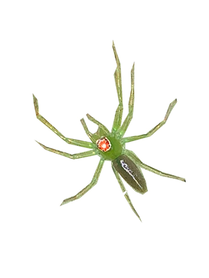
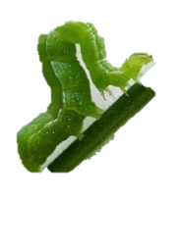
What have we learned?
The abundance of bird food varies A LOT from place to place!
And with host plant species.
PLANT NATIVES!
Narango, Tallamy & Marra 2018

Slide 19
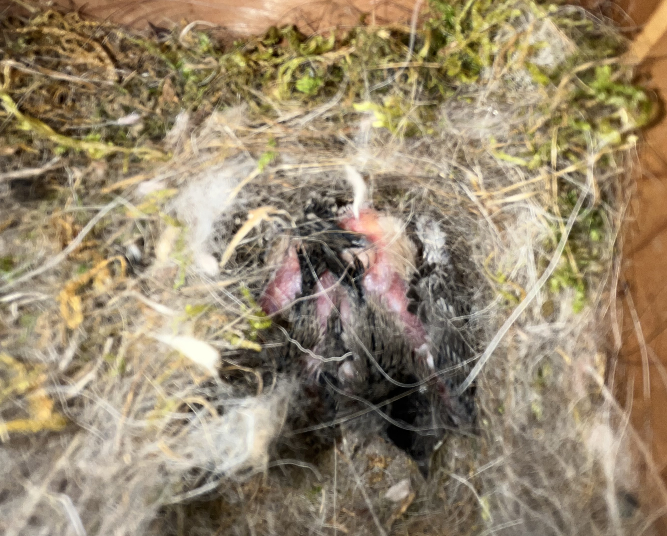
What have we learned?
The abundance of bird food varies A LOT from place to place!
And with host plant species.
PLANT NATIVES!
Narango, Tallamy & Marra 2018

Slide 20
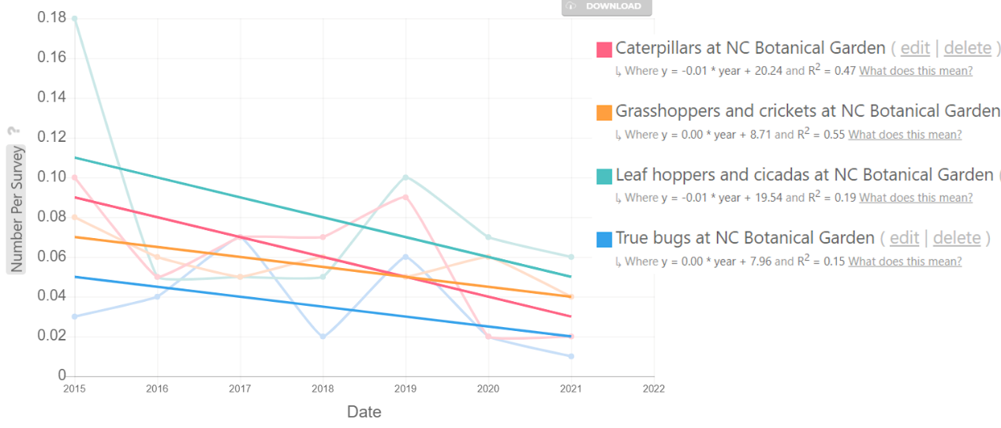
What have we learned?
Is bird food declining in general?
More in some places than others?
Trends

Slide 21
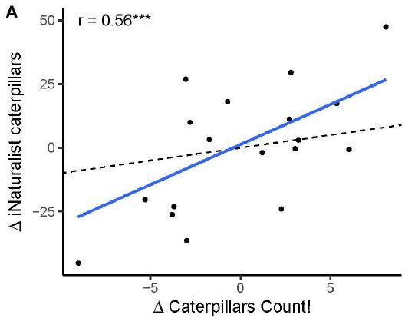
How do caterpillar phenology patterns compare with iNaturalist?
Earlier (-) or later (+) than normal?
Number of days earlier or later than average
Di Cecco et al. 2023
Do caterpillars come out earlier (-) or later (+) than normal?

Slide 22
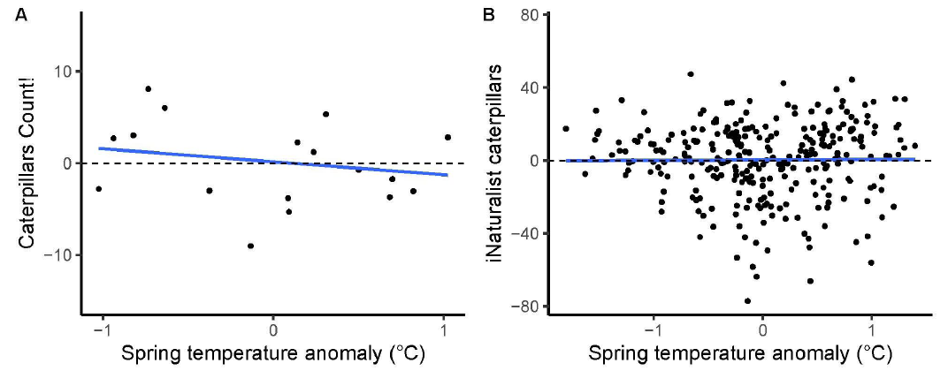
How do caterpillar phenology patterns compare with iNaturalist?
earlier cats← → later cats
colder years ← → warmer years
Di Cecco et al. 2023

Slide 23
What are all of the ways that Caterpillars Count! data could be unreliable?
What steps could be taken BEFORE data are collected to increase reliability?
What steps could be taken AFTER data are collected to increase reliability?

